Slide 1



Slide 2
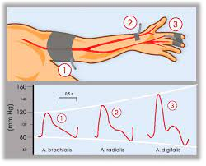
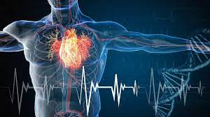

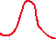

Slide 3
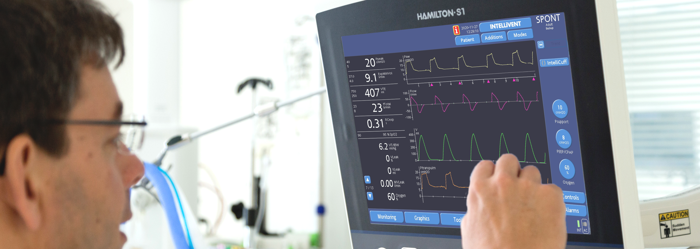
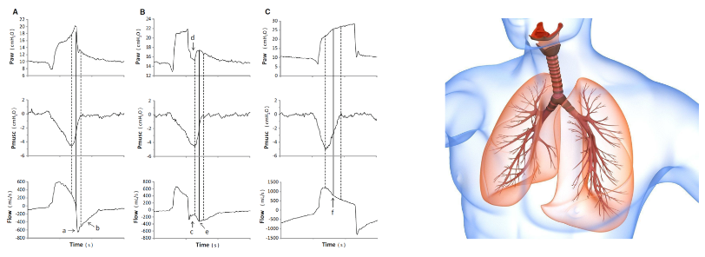

Slide 4

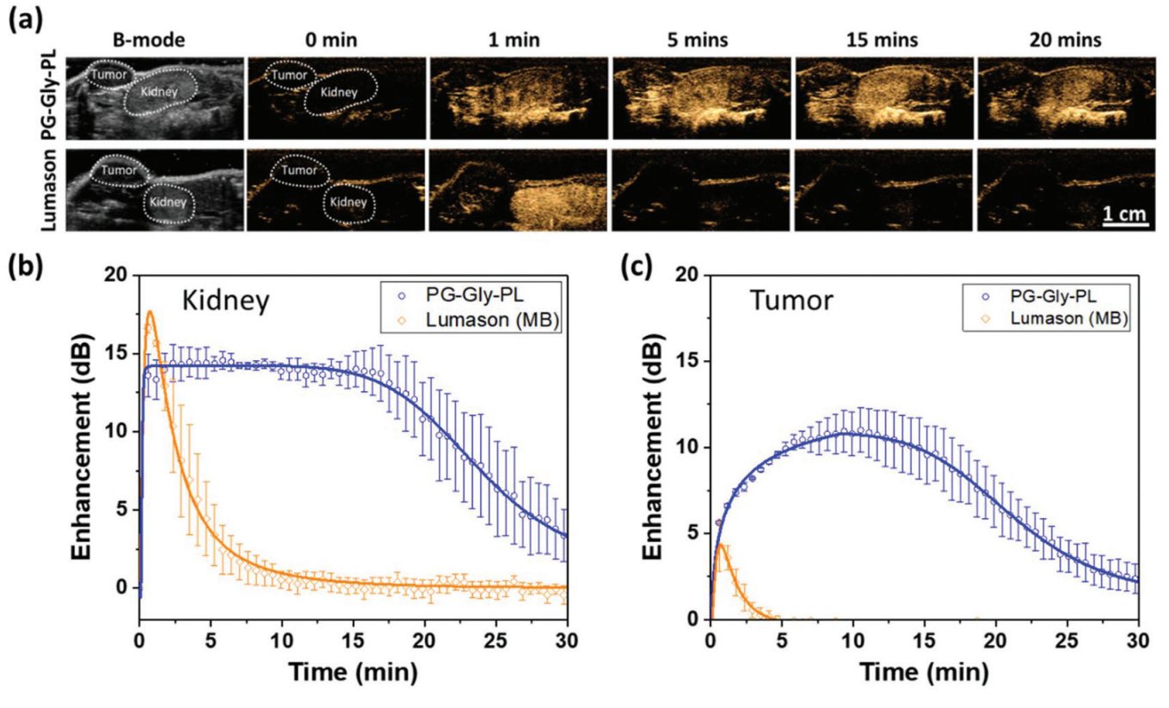
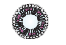
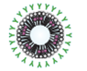

Slide 5
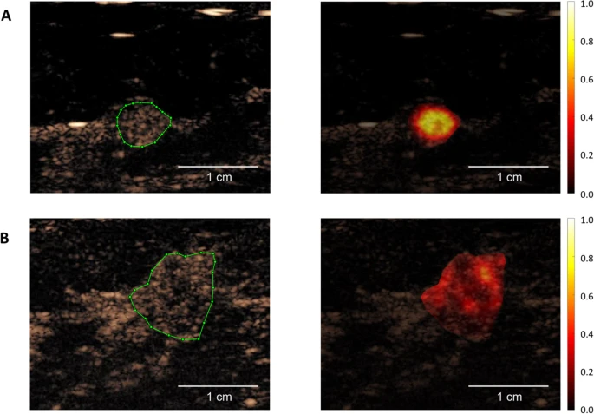
Benign
Malignant

Slide 6
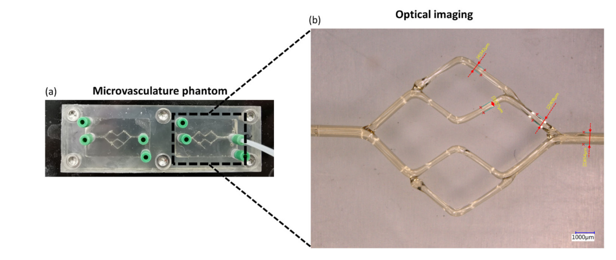
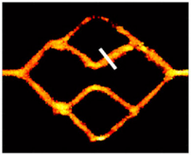
Superlocalization map

Slide 7
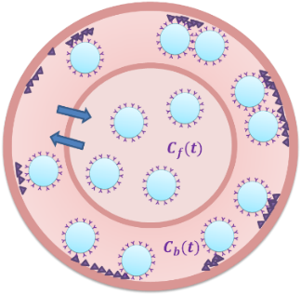
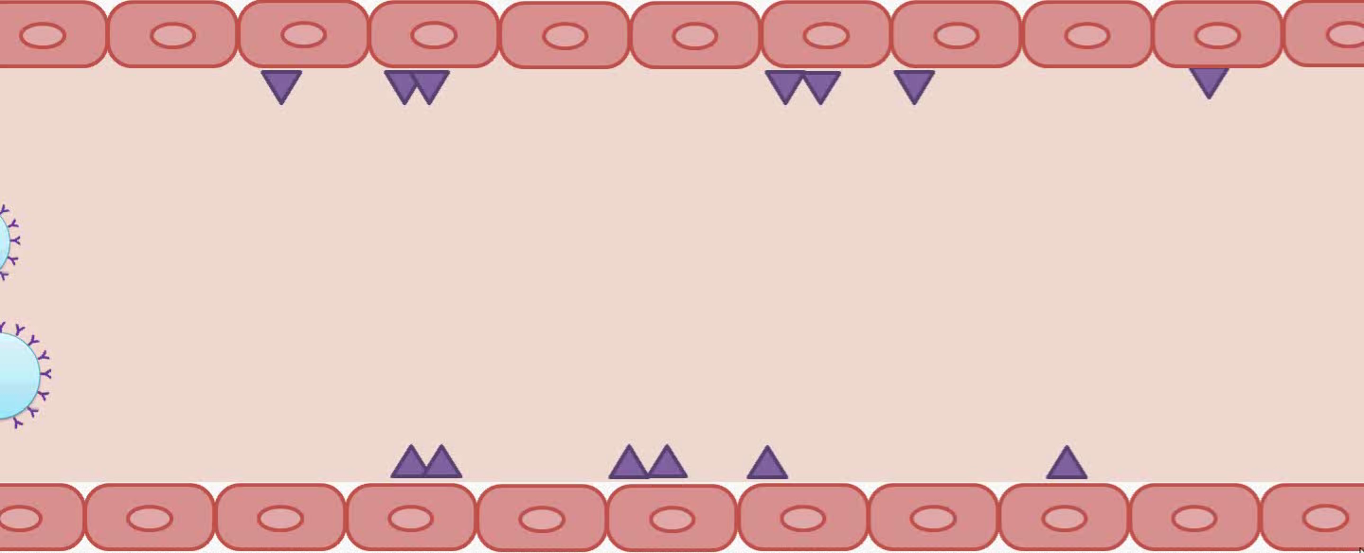


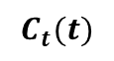
$$C_{f}(t)$$
$$C_{b}(t)$$
$$C_{t}(t)$$

Slide 8

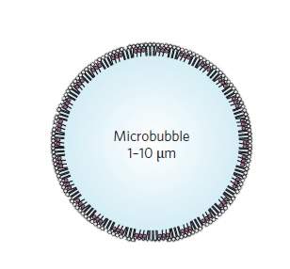
Microbubble
(1-10 μm)
Nanobubble
(~0.3 μm)

Slide 9
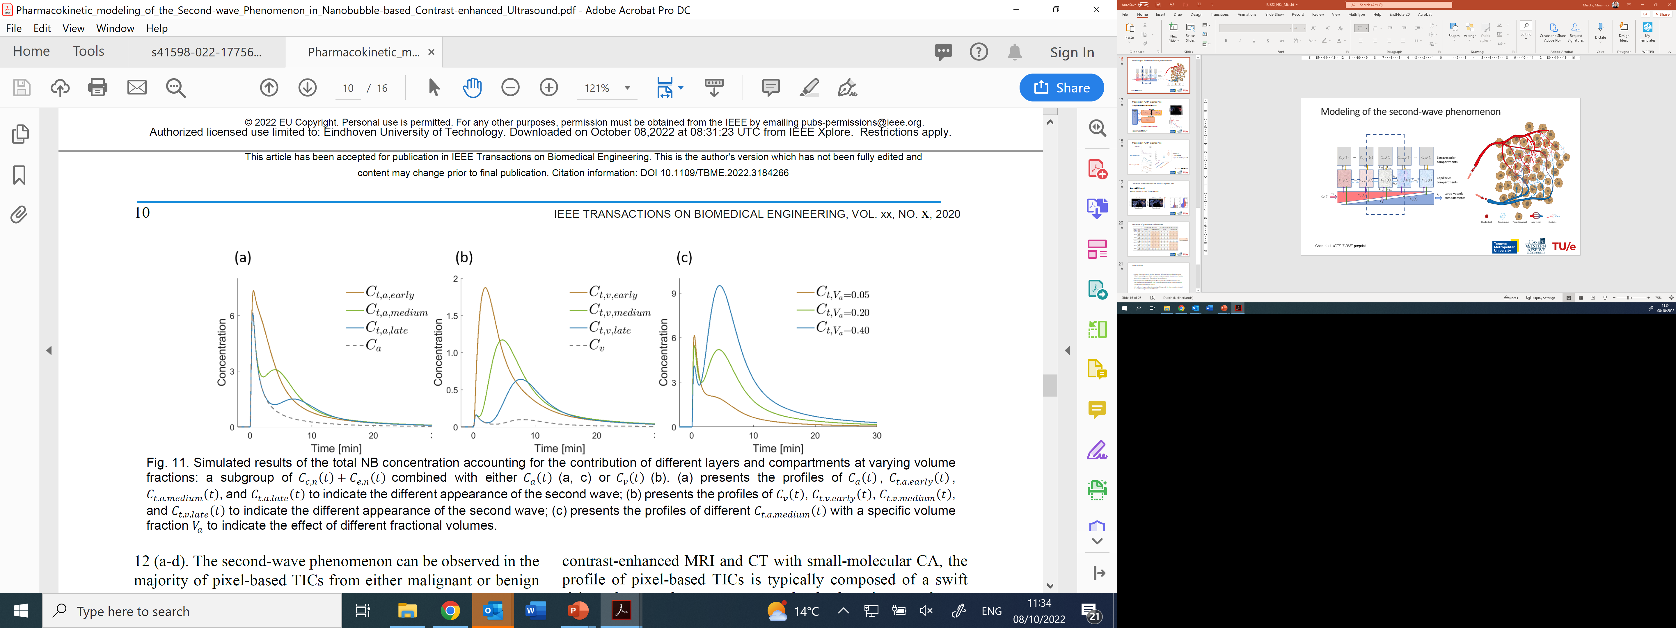
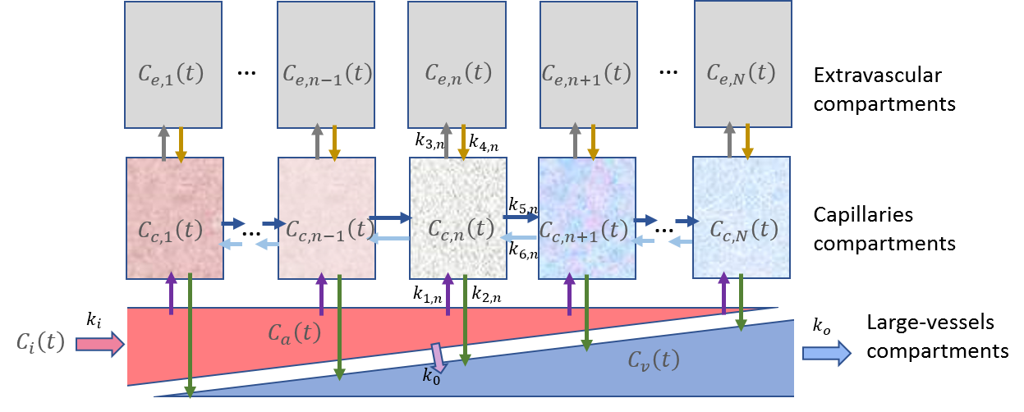

Slide 10
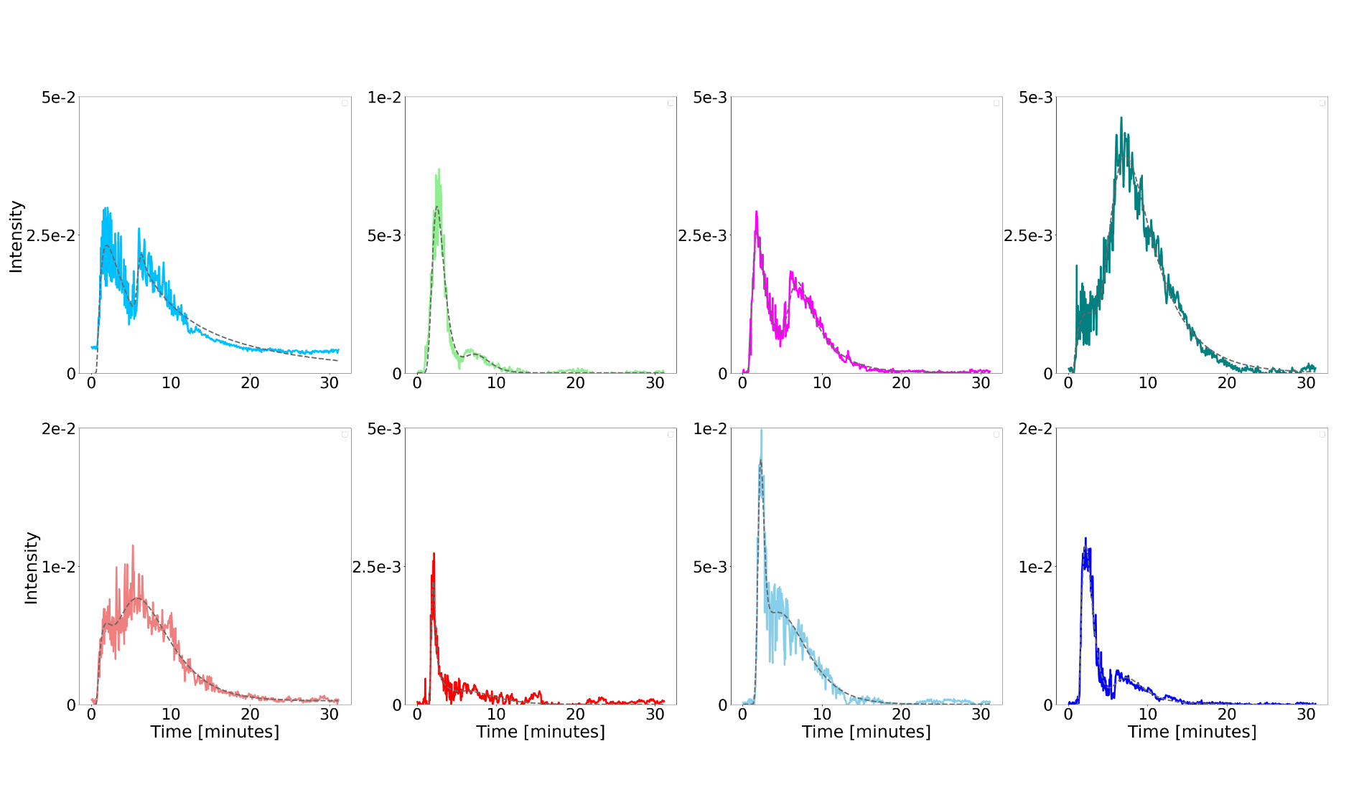
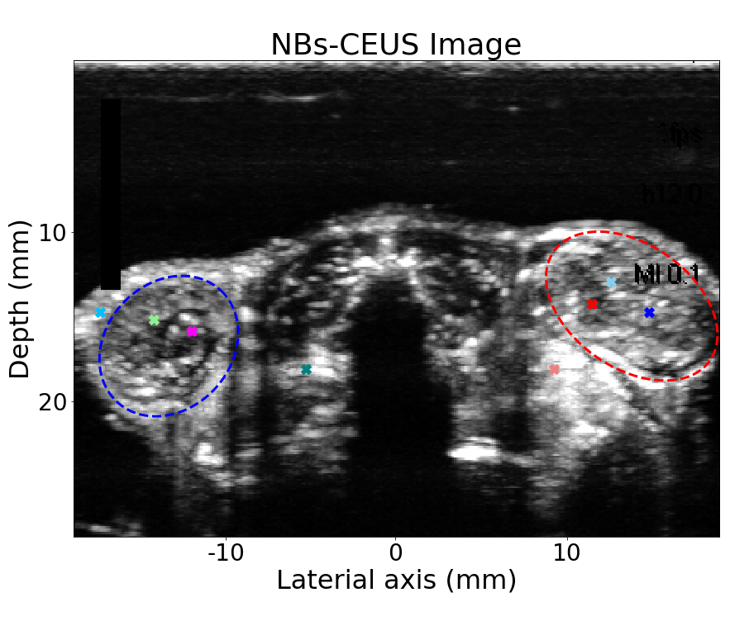
(free) NB-CEUS Image
Tissue
Left PC3flu
tumor
Left PC3flu
tumor
Tissue
Tissue
Right PC3pip
tumor
Right PC3pip
tumor
Right PC3pip
tumor

Slide 11
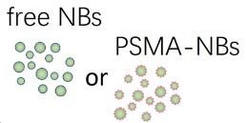



PSMA (+)
PC3pip tumor
PSMA (-)
PC3flu tumor
Kidneys
US imaging plane

Slide 12
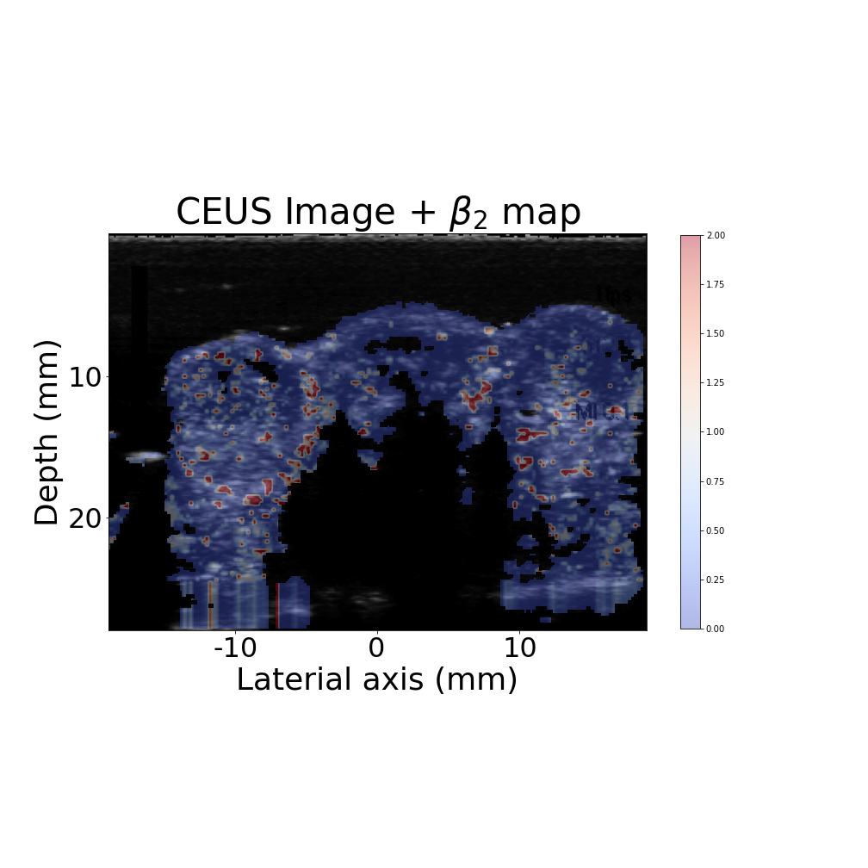
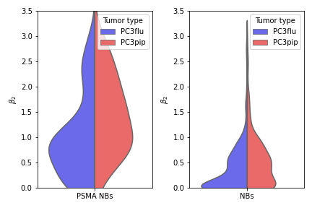
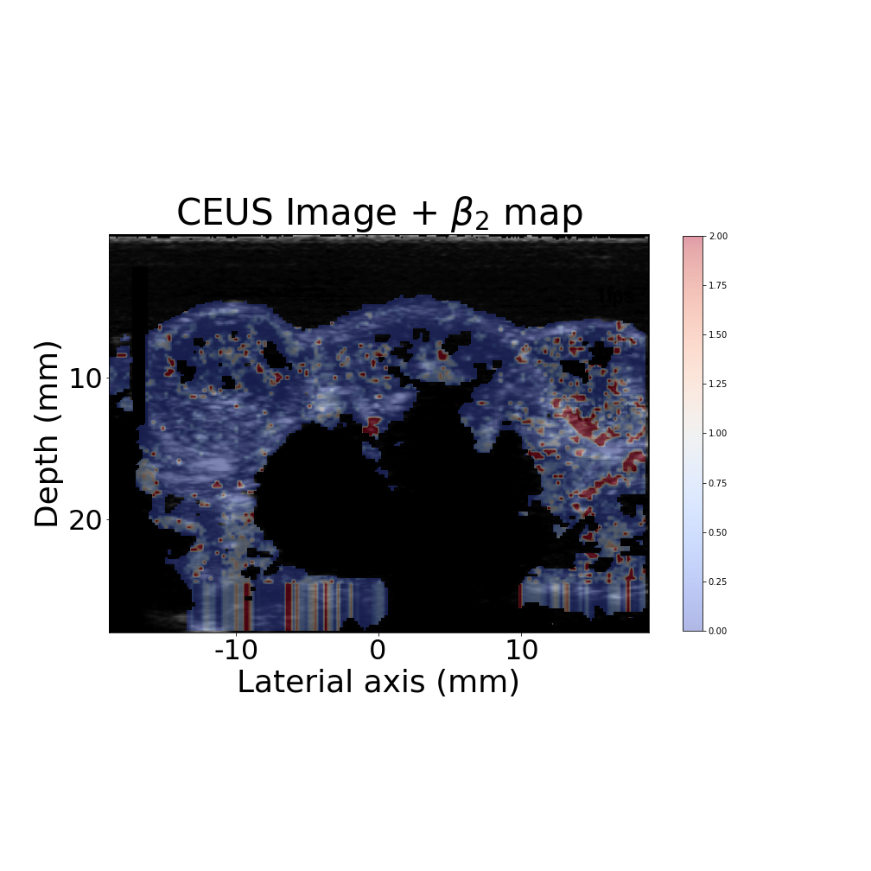
Relative intensity of the 2nd wave retention ($β_{2}$)
25% or 75% quartile value
Free NBs
Median value
PSMA-targeted NBs
2.00
PSMA+
PSMA-
PSMA+
PSMA-
1.00
0.00
Free NBs
PSMA-targeted NBs

Slide 13



